Slide 2

DECONSTRUCTING THE CLOUD
Cross VM Side-Channel Attacks on L1 I-Cache
by Aditya Wate
Image courtesy of Stuart Miles at FreeDigitalPhotos.net

Slide 3
Side Channel Attacks
Time-driven: Statistically inferring from execution timing
Trace-driven: Monitoring some aspect of the device
Access-driven: Usage of a shared architectural component

Slide 4
Threat Model
Attacker and Victim are separate guest VMs
Logical isolation between mutually untrusting co-resident VMs
Software vulnerabilities are not exploited to gain root of the other machine

Slide 5
Setup
Dom0
DomU
DomV
VCPU
Core 0
Core 1
Core 2
L1 Inst
PCPU
L1 Inst
L1 Data
L1 Inst
L1 Data
L1 Inst
L1 Data
L1 Inst
L1 Inst
L2
L2
L2
Unified L3

Slide 6
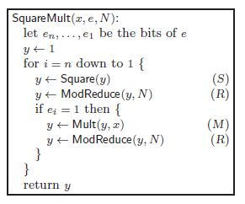
Classifying Code Paths
For e=2 the operation sequence will be SRMRSR
Image courtesy of ‘Cross-VM side channels and their use to extract private keys’

Slide 7
Cache pattern classifier
Classification of S,M and R vectors
Using SVM (support vector machine)
Training on a controlled but similar architecture machine
Communication of the results is required to get the readings
Utilize the memory pages shared between VMs

Slide 8
Set Objectives
Provide tools to replicate the attack
Publish manuals for the ease of use
Try the attack on different architecture (or platform)
  SGX
  Non Xen Virtualization
All the above will prove the feasibility of such attacks

Slide 9

Steps
Environment Setup
Measurement
  Prime and probe
  Write libsync
  Modify libgcrypt
Analysis
  ML using SVM
  Noise reduction using (HMM)
Image courtesy of Master isolated images at FreeDigitalPhotos.net

Slide 10
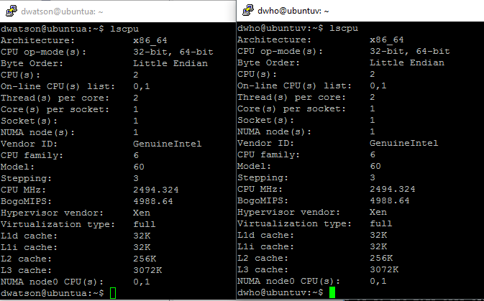
Processor Specs on XenServer 6.2

Slide 11
Mapping: Prime-Probe
m sets with w lines of b size, cache size = c.
m = c/(w*b)
m = 64 (c=32K, w=8, b=64B)
Cache line blocks in memory page = 4K/b = 64
Memory blocks with the same offset will map to the same cache set

Slide 12
Prime & Probe: Strategy
Fill cache set associated to block offset i
Execute instruction in i^{th} block of each of the allocated pages
t₁:=rdtsc
Jump to first page’s i^{th} block which has instruction to next pages i^{th} block
Final page jumps to rdtsc (t₂)
Time taken = t₂-t₁

Slide 13


libsync
Functions:
  writelabels()
  writelabelr()
  writelabelm()
Writing to file
  Shared memory option
Image courtesy of Stuart Miles at FreeDigitalPhotos.net

Slide 14
Modified libgcrypt
Internal MPI library
Modified mpi-pow.c
  gcry_mpi_powm (gcry_mpi_t res, gcry_mpi_t base, gcry_mpi_t expo, gcry_mpi_t mod)
To call the functions in libsync to generate labels

Slide 15
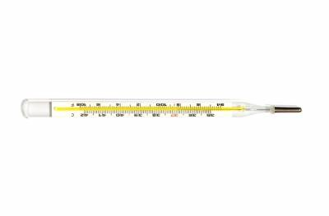
Measurement
Calculating [ x^{e} mod n ] for e with all bits 1
Run exponentiation and prime & probe simultaneously to take readings
This generates two files:
  label.txt:S/M/R & timings.bin: Reading for all cache sets
Image courtesy of PANPOTE at FreeDigitalPhotos.net [id=10045561]

Slide 16
Supervised Learning
libsvm provides tools for supervised learning
  https://github.com/cjlin1/libsvm
Input format:
  <label> <index1>:<value1> <index2>:<value2> ...
Writing python script to generate this format

Slide 17
Results
Code for prime and probe, libsync and measurement has been pushed to github
  https://github.com/aditya-wate/cross-vm-side-channel
Manual of the completed work
Extraction of cache timing vector is feasible

Slide 18
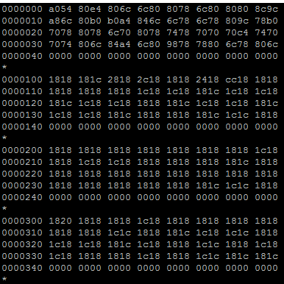
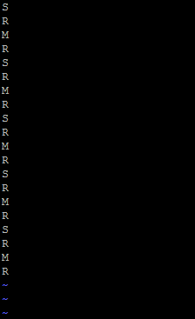
Results contd..

Slide 19
Future Scope
Benchmarked code can be used to experiment with similar side channel attacks
SVM and HMM models to be used for machine learning and error correction
Performing side-channel on Intel SGX

Slide 20

Challenges
Grant table
  Xen Inter-domain memory sharing
Libvchan
  Library to user grant tables
Kernel updates
Kernel modules
Shared memory
  sys/shm.h
Image courtesy of renjith krishnan at FreeDigitalPhotos.net [ID-10047691]

Slide 21
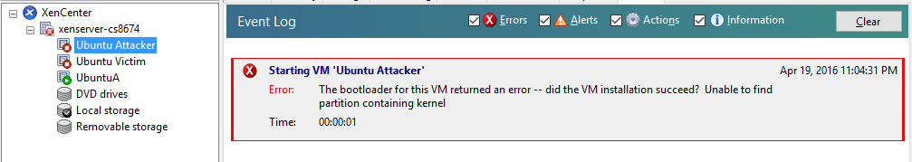
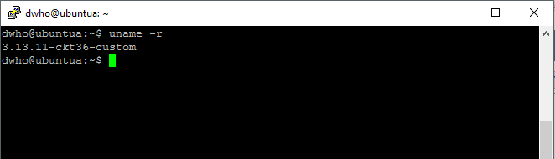
Challenges

Slide 22

Q & A
Image courtesy of Master isolated images at FreeDigitalPhotos.net (Image ID: 10051444)

Slide 23
THANKS

